Slide 1

ST841 Group 7 Tax Analytics and Automation
Drew Hollis, Xinyu Zhang, Qiang Heng

Slide 2

Seven Factors
What factors are related to the three-stage diffusion of tax analytics and automation (TAA) technologies in corporate tax departments?
Technology Readiness
Technology Integration
Firm Size
Global Scope
Managerial Obstacle
Competition Intensity
Regulatory Environment
Initiation
Adoption
Routinization

Slide 3

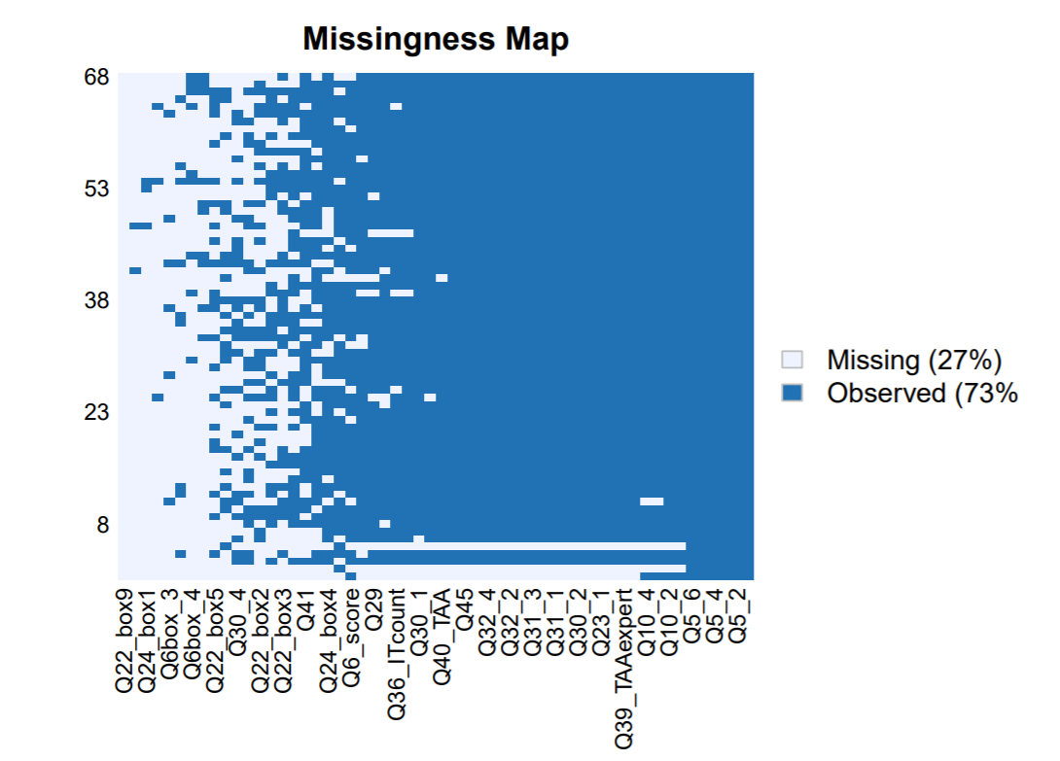
Survey Design
The client design a survey with 23 questions selected for analysis to quantify the ten variables.
65 valid responses are collected from the Fortune 1000 companies.
Two problems:
Missing value imputation.
Combine Likert Items.

Slide 4
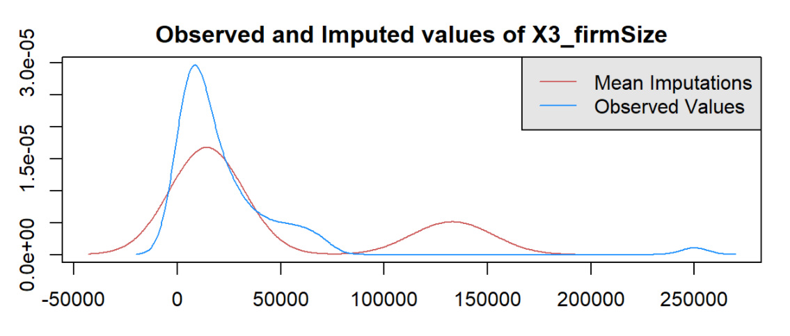
Missing Value Imputation
Amelia
EM Algorithm
Multivariate regression
Assumption
Discrete Likert scale still need to be taken care

Slide 5
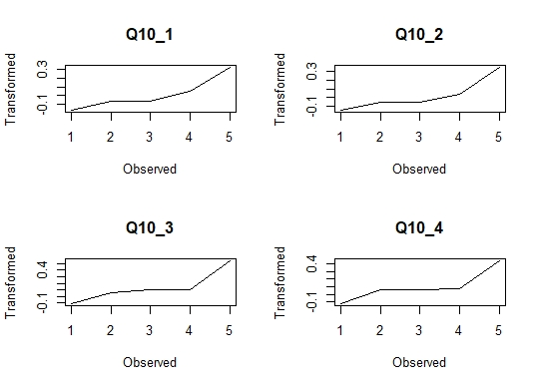
Likert Variable Transformation
2 response variables and 4 explanatory variables are measured using a collection of Likert scale questions.
We combine the Likert scale data for each variable into a single continuous measure, which can be done using non-linear principal components analysis.
The technique works by optimally transforming the Likert data to a continuous scale and then performing regular PCA on the transformed data.

Slide 6

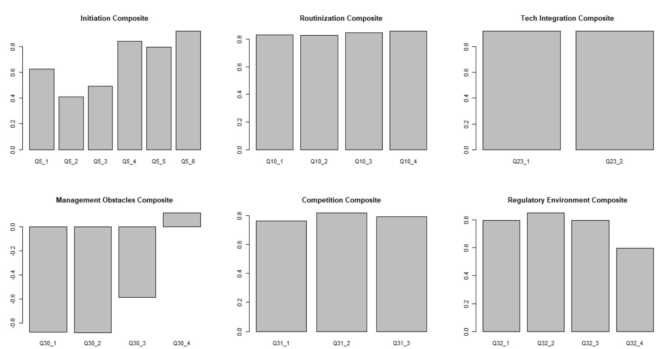
Loadings of Likert Transformation

Slide 7
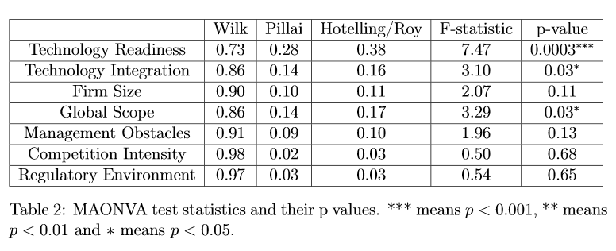
MANOVA Result

Slide 8
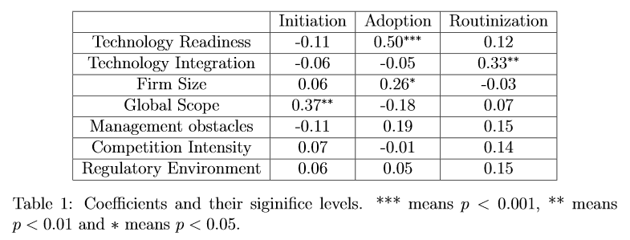
Regression Result

Slide 9
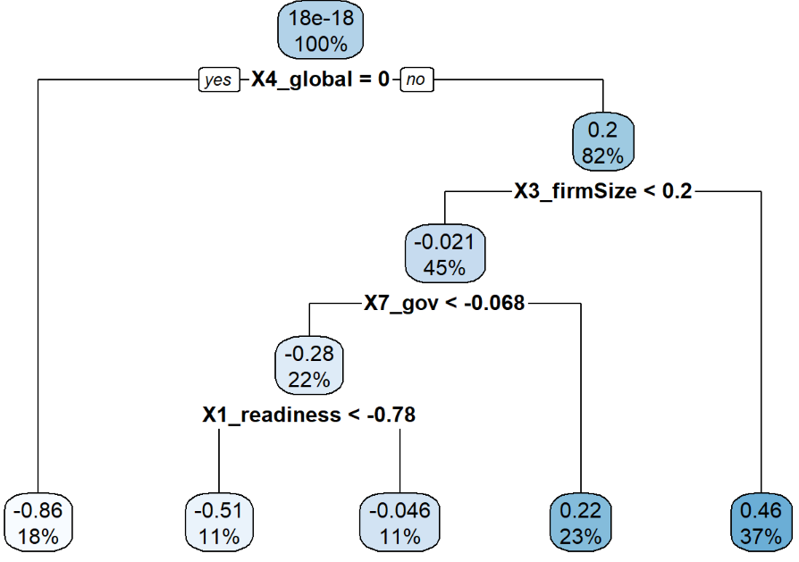
Regression Tree – Initiation

Slide 10
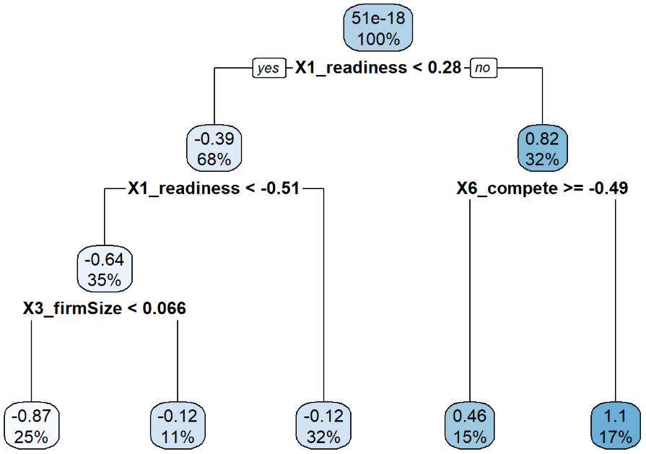
Regression Tree – Adoption

Slide 11
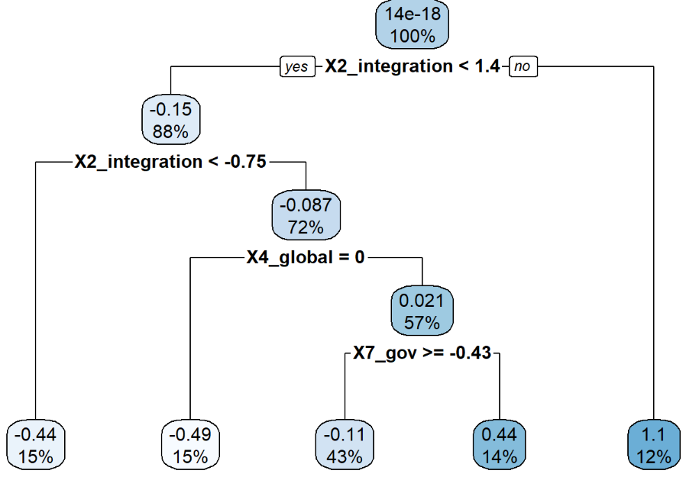
Regression Tree – Routinization

Slide 12

Discussion and Remark
Multivariate Regression
Provide significance level.
Highly depend on model assumption.
Decision Tree
No parameter needed.
High interpretability.
Highly dependent on data.

Slide 13
Thank you!

